Slide 1
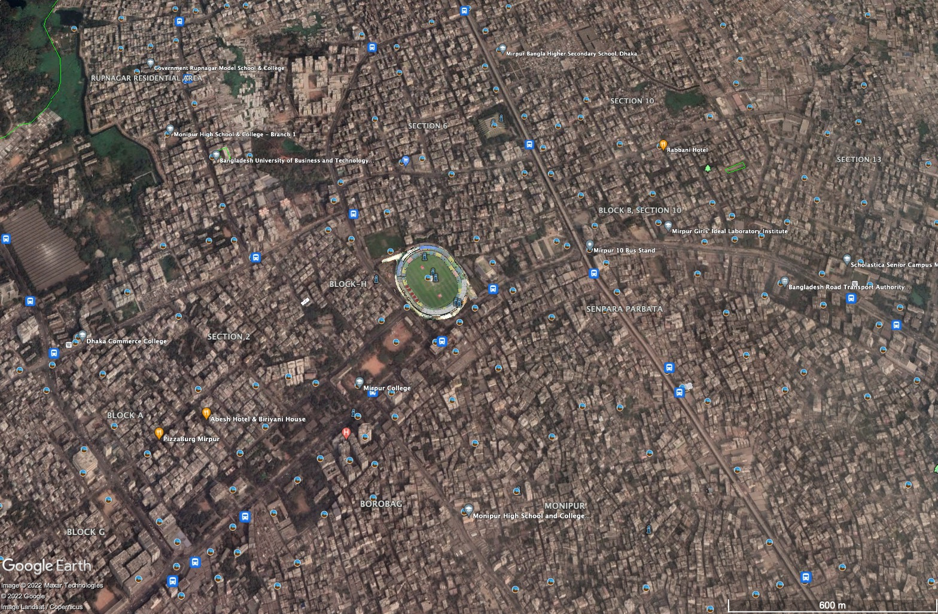
. ..
.
.
1.Salman Farshi
2.Md. Ashiquer Rahman 3.Iftakarul Islam Suvo
Superviser : Shahnewaz Siddique

Slide 2
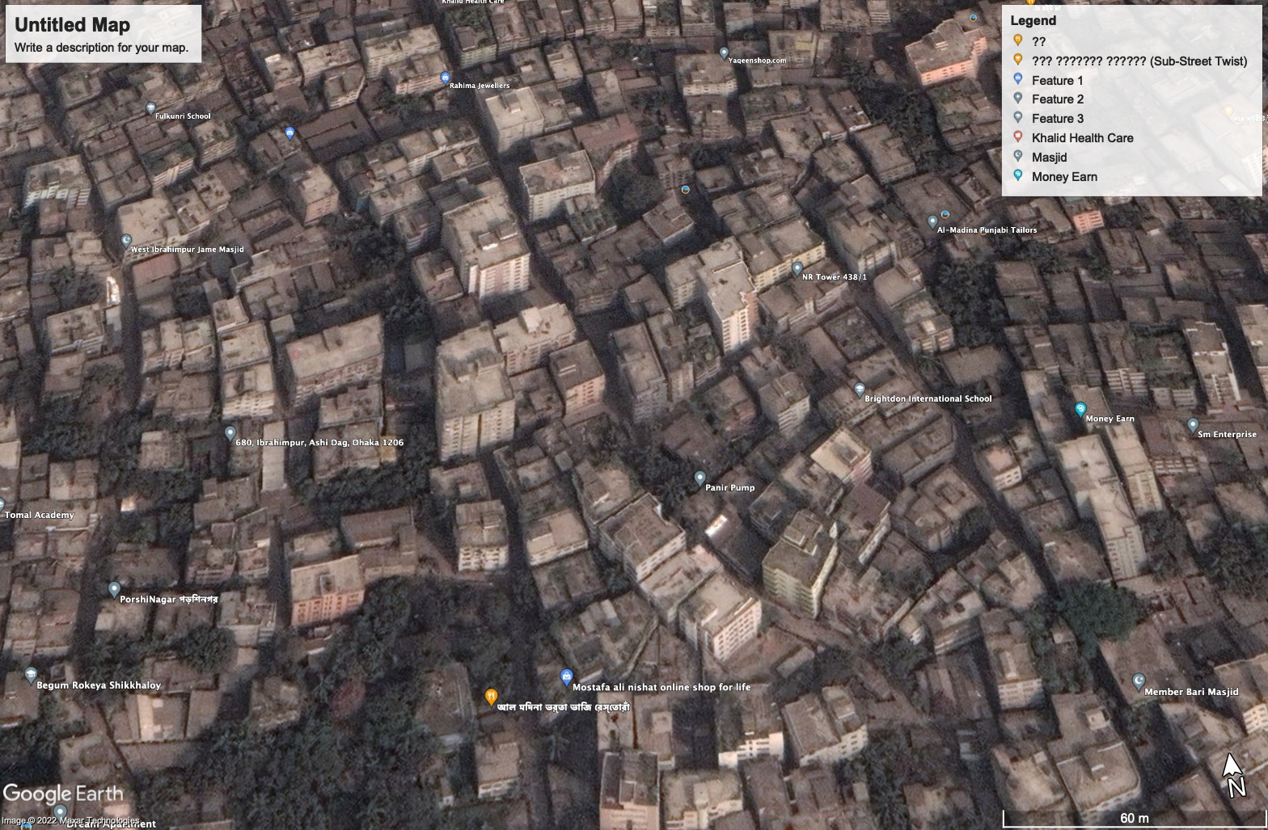
H
ff
Risky building detection of Dhaka city from satellite images using deep learning

Slide 3
Bangladesh is one the most populated country in the world. Dhaka is also one of the most densely populated cities in the world having more than 2 core people. But it is a very alarming fact that about 90% of buildings in Dhaka city are very risky and those buildings may collapse any time due to natural hazards like earthquakes. Our team wants to find the solution for this problem which will identify the risky building of Dhaka city from satellite images using deep learning technology which can help the authority to determine the riskiest area and also can help to take proper steps to ensure the proper safety
Problems

Slide 4
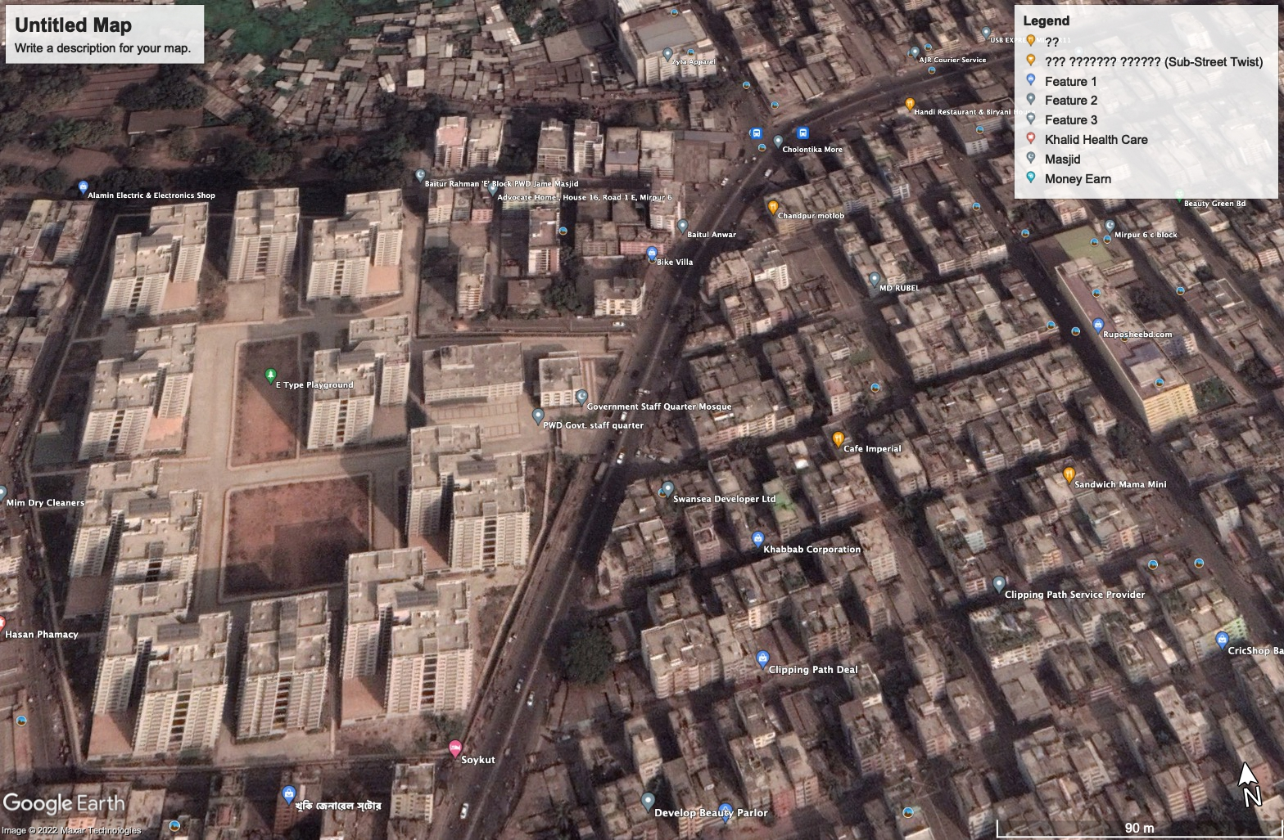
AIDA
h

Slide 5
.
Why Deep learning ?
If computer has vision , so why not use of it
1.Easy to Detect
2.Short Time
3.Less Costly 4.Easy to Manage 5.Better Accuracy

Slide 6
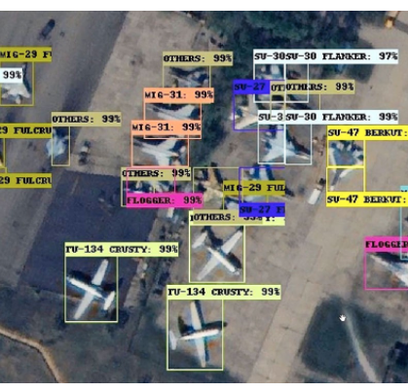
AIDA
AIDA Presentation
Template
Deep learning Architecture for object detection (Computer vison)
1.Convolutional neural network (CNN)
2.CNN with region proposals (R-CNN)
3.You only look once (YOLO)
4.Single shot multi-box detector (SSD) Transfer learning
There are many variations of passages of Big Daddy available, but the majority have suffered alteration in some form.
Various versions have evolved over the years, sometimes by accident, sometimes on purpose.

Slide 7
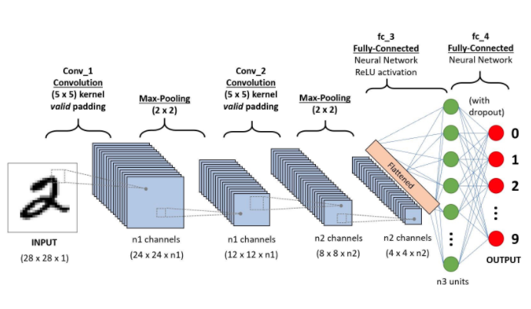
AIDA
1.Convolutional neural network (CNN)
A Convolutional Neural Network (CNN) is a Deep Learning algorithm which can take in an input image, assign importance (learnable weights and biases) to various aspects/objects in the image and be able to differentiate one from the other.

Slide 8
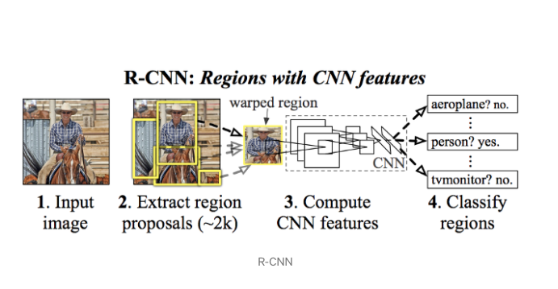
AIDA
2. CNN with region proposals (R-CNN)
02.
Various versions have evolved over the years, sometimes.
04.
Various versions have evolved over the years, sometimes.
03.
Various versions have evolved over the years, sometimes.
01.
Various versions have evolved over the years, sometimes.
To bypass the problem of selecting a huge number of regions, Ross Girshick et al. proposed a method where we use selective search to extract just 2000 regions from the image and he called them region proposals. Therefore, now, instead of trying to classify a huge number of regions, you can just work with 2000 regions

Slide 9
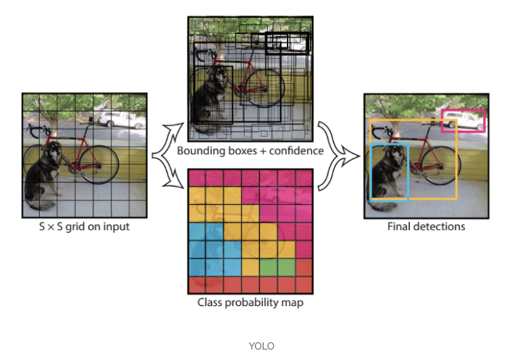
AIDA
3.You only look once (YOLO)
02.
Various versions have evolved over the years, sometimes.
04.
Various versions have evolved over the years, sometimes.
03.
Various versions have evolved over the years, sometimes.
All of the previous object detection algorithms use regions to localize the object within the image. The network does not look at the complete image. Instead, parts of the image which have high probabilities of containing the object. YOLO or You Only Look Once is an object detection algorithm much different from the region based algorithms seen above. In YOLO a single convolutional network predicts the bounding boxes and the class probabilities for these boxes.
01.
Various versions have evolved over the years, sometimes.

Slide 10
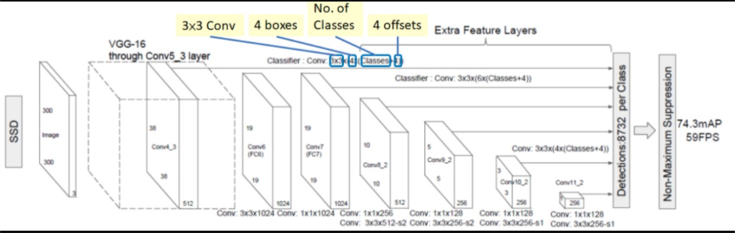
4.Single shot multi-box detector (SSD)
AIDA
02.
Various versions have evolved over the years, sometimes.
04.
Various versions have evolved over the years, sometimes.
03.
Various versions have evolved over the years, sometimes.
By using SSD, we only need to take one single shot to detect multiple objects within the image, while regional proposal network (RPN) based approaches such as R-CNN series that need two shots, one for generating region proposals, one for detecting the object of each proposal. Thus, SSD is much faster compared with two-shot RCN-based approaches.The SSD detector differs from others single shot detectors due to the usage of multiple layers that provide a finer accuracy on objects with different scales.
01.
Various versions have evolved over the years, sometimes.

Slide 11



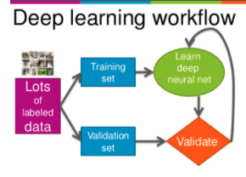
AIDA
What has been completed so far.

Slide 12
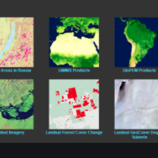
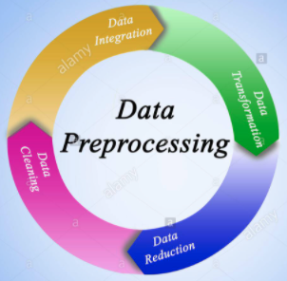
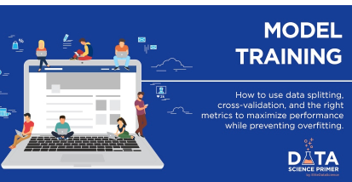
AIDA
What will be completed next.

Slide 13


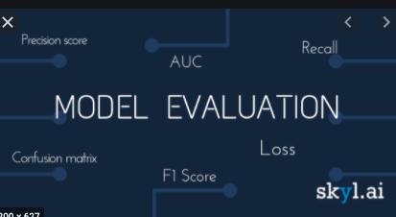
AIDA
What will be completed next.

Slide 14
Thanks

